Slide 1
MUNCH
Progress Report #3
Gabriel Soares & Gabriel Mendonca

Slide 2
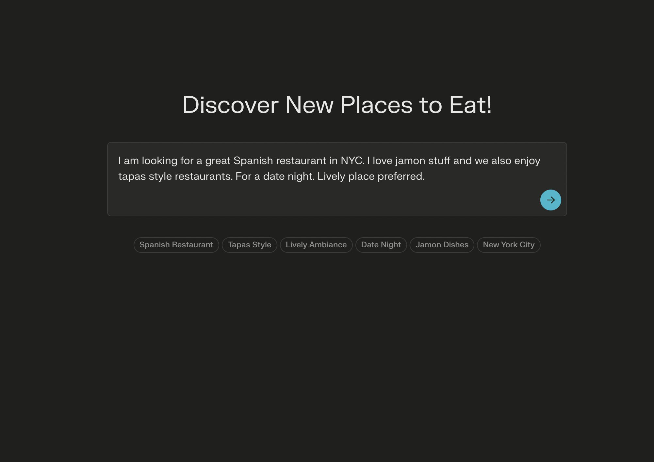

Slide 3


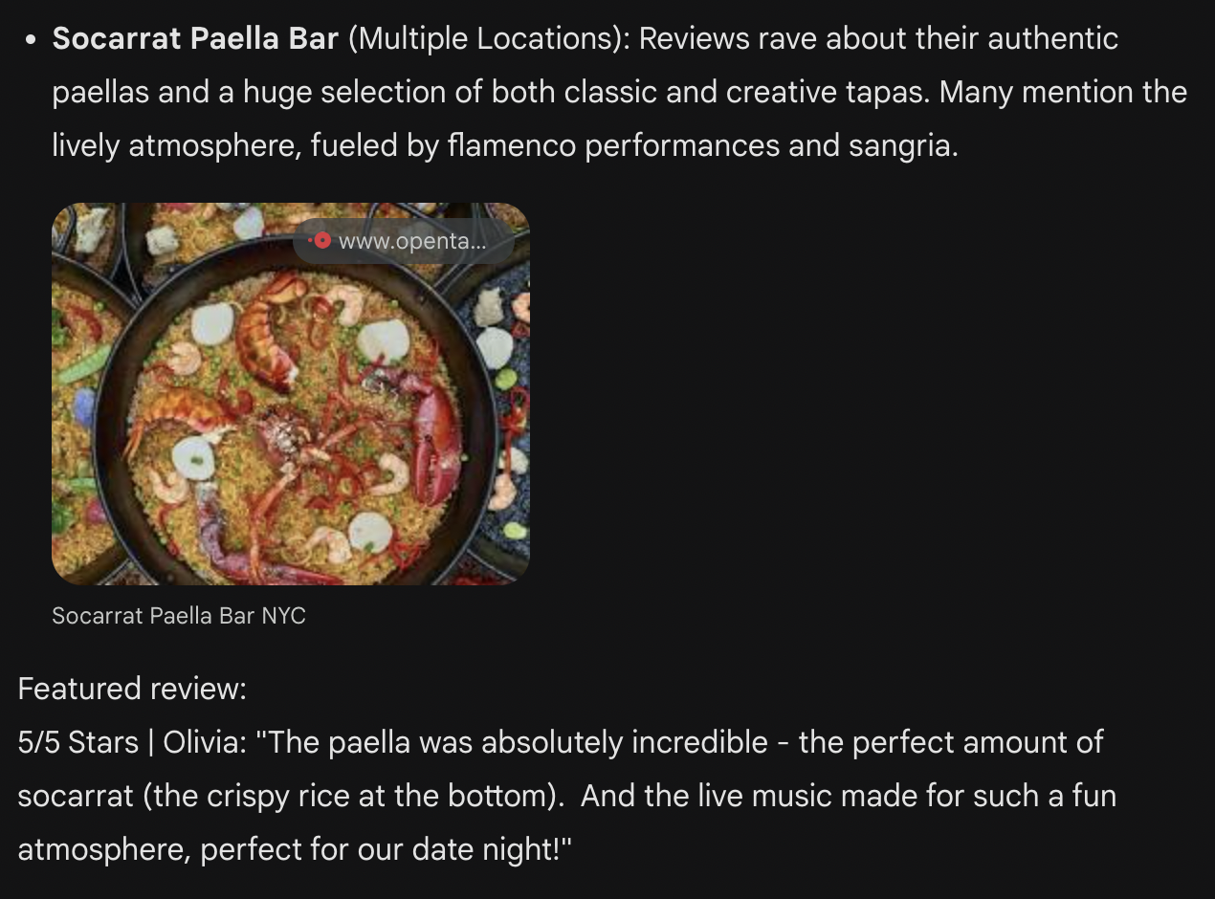
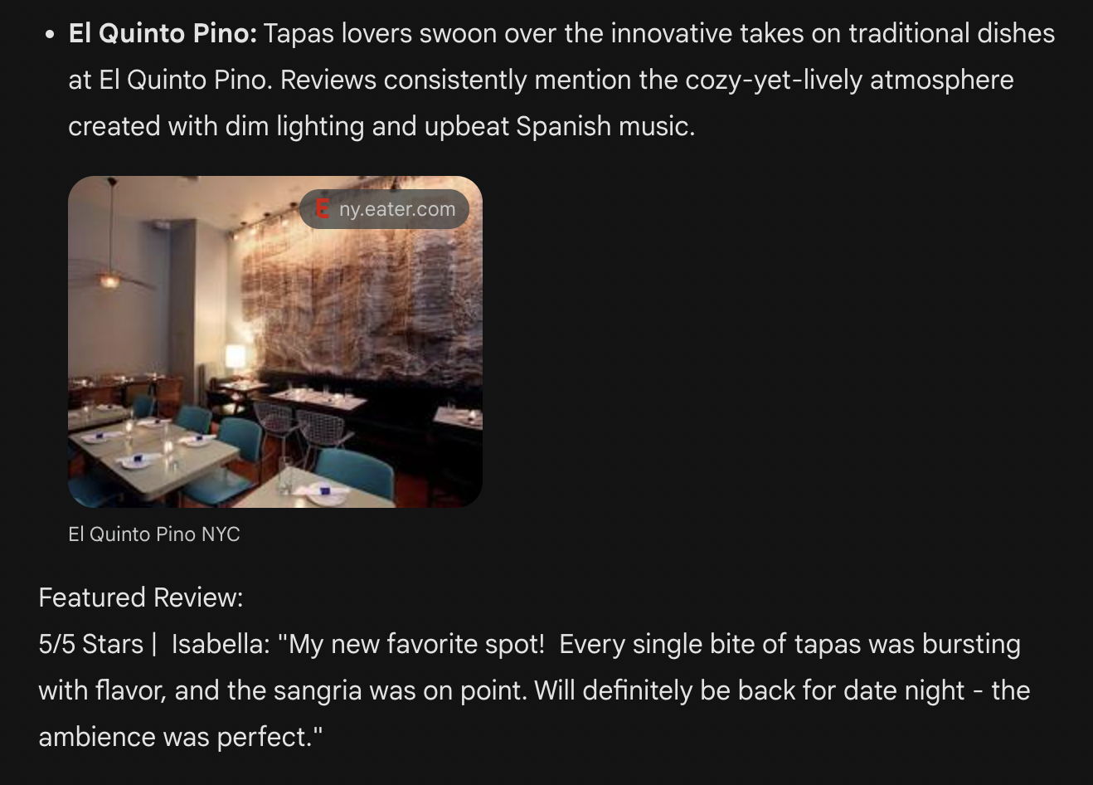
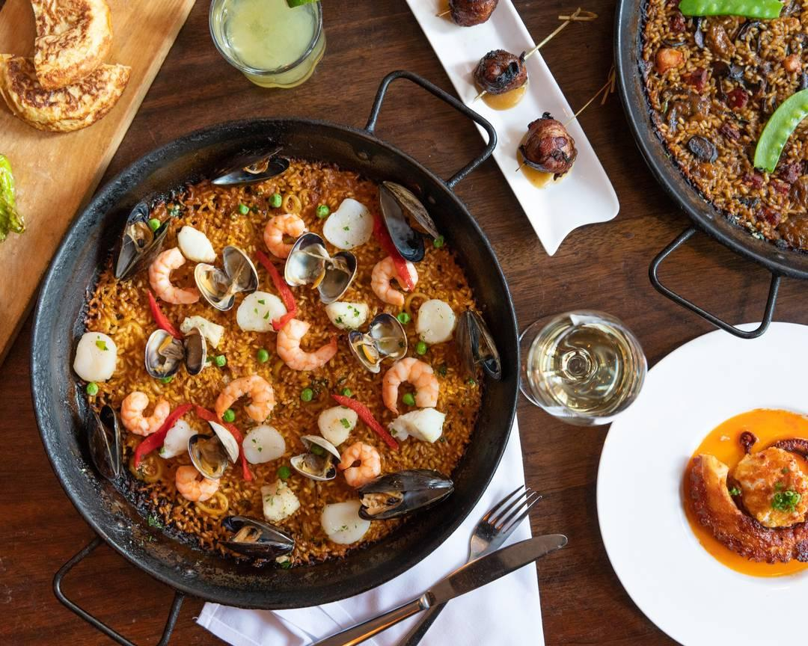
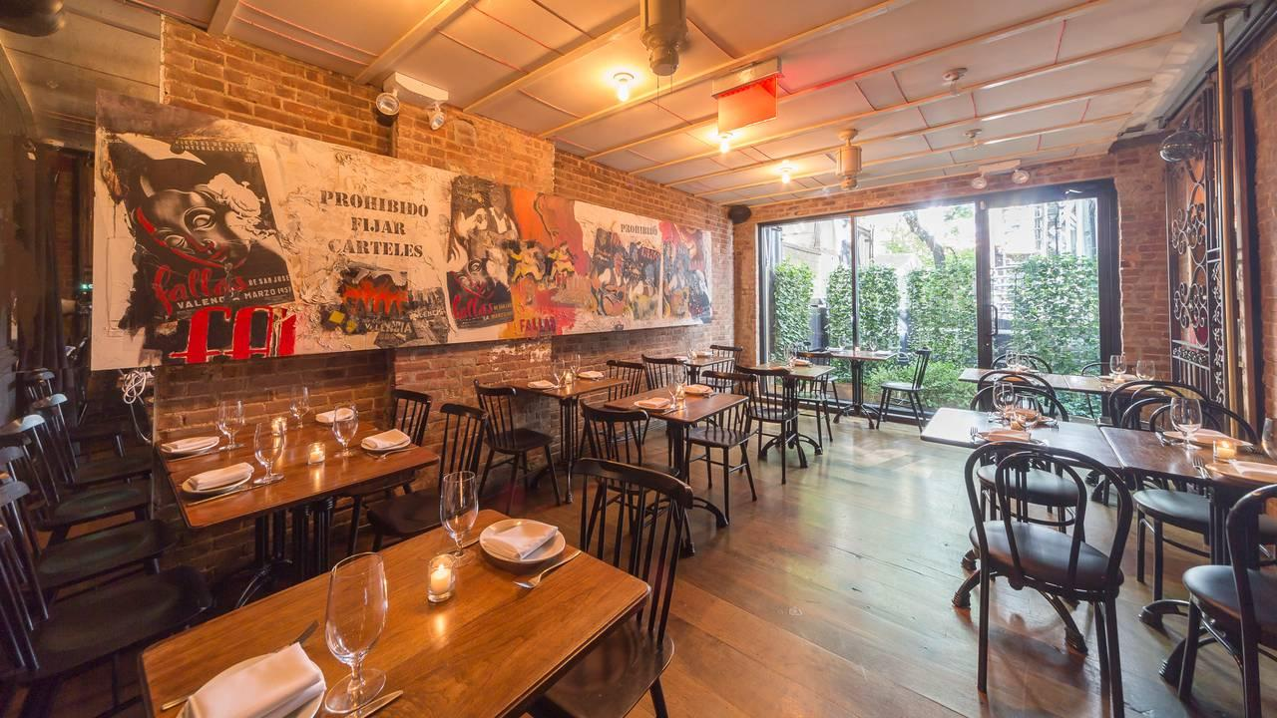
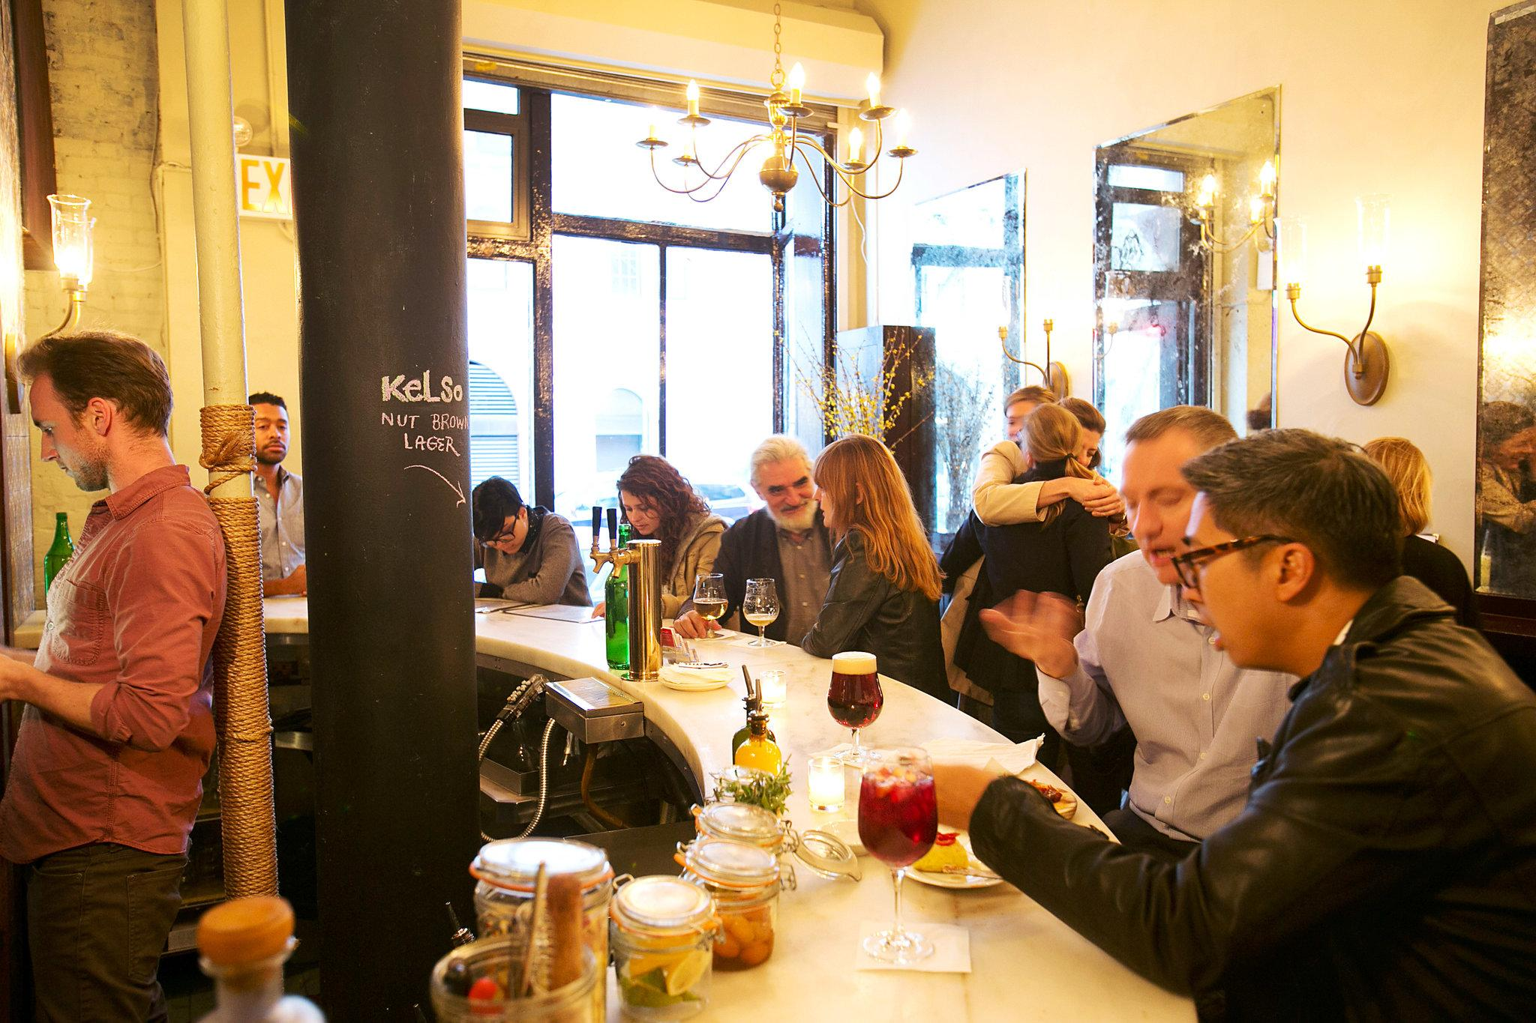
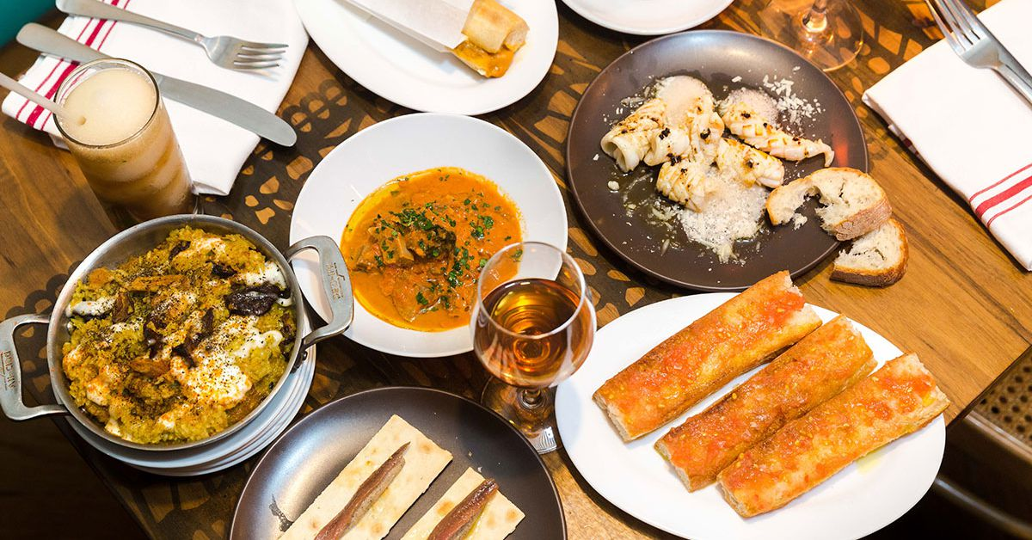
Example Search Results

Slide 4
Table of Contents
01
02
03
04
05
Timeline
Web App
Search V2
Data & Hosting
Questions?
Notes:
Soares

Slide 5
01
Timeline
Notes:
Soares

Slide 6
Project Timeline
Week 1-2 (Feb 20 - Mar 5)
Finalize Restaurant Search V1.
Setup GitHub and Trello for tasks.
Finalize entire project concept and decide what features the app will have + tech stack to build.
Week 7-8 (Apr 3 - Apr 16)
Finalize Llama search V2 (include RAG and review dataset logic for better ranking).
Prototype of the overall app for testing.
Polish UI and UX designs.
Week 3-4 (Mar 6 - Mar 19)
UI/UX Design: Draft initial Figma designs and user flow wireframes.
Optimize restaurant search V1 - Expand filtering capabilities and polish LLM response structure.
Week 9 (Apr 17 - Apr 23)
Finalize frontend development.
Conduct intense testings on the search feature and polish the algorithm/add missing features.
Week 5-6 (Mar 20 - Apr 2)
Finalize development of backend infrastructure.
User authentication implemented.
Basic frontend version working.
Figure out data storing and app hosting
Week 10-11 (Apr 24 - May 1)
Fully ready V1 of the app.
Address any remaining issues or bugs.
Present final project & collect feedback for improvements.
Notes:
Soares

Slide 7
Project Timeline
Week 1-2 (Feb 20 - Mar 5)
Finalize Restaurant Search V1.
Setup GitHub and Trello for tasks.
Finalize entire project concept and decide what features the app will have + tech stack to build.
Week 7-8 (Mar 25 - Apr 3)
Finalize Llama search V2 (include RAG and review dataset logic for better ranking).
Prototype of the overall app for testing.
Polish UI and UX designs.
Week 3-4 (Mar 6 - Mar 19)
UI/UX Design: Draft initial Figma designs and user flow wireframes.
Optimize restaurant search V1 - Expand filtering capabilities and polish LLM response structure.
Week 9 (Apr 3 - Apr 23)
Finalize frontend development.
Conduct intense testings on the search feature and polish the algorithm/add missing features.
Week 5-6 (Mar 20 - Mar 25)
Finalize development of backend infrastructure.
User authentication implemented.
Basic frontend version working.
Figure out data storing and app hosting
Week 10-11 (Apr 24 - May 1)
Fully ready V1 of the app.
Address any remaining issues or bugs.
Present final project & collect feedback for improvements.
Notes:
Soares

Slide 8
02
Initial Web App Setup

Slide 9
Initial Web App Setup
Main Flask Routes Set
Authentication Logic Fully Working
User account/info storing is Implemented
Skeleton Web App is Setup

Slide 10

Initial Web App Setup

Slide 11
QUICK DEMO

Slide 12
03
Search V2

Slide 13


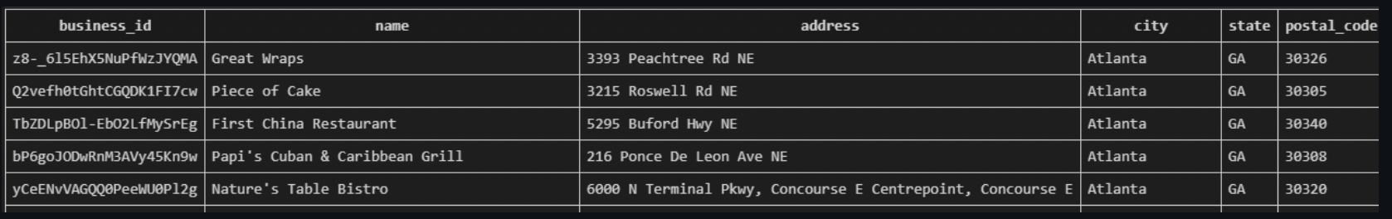

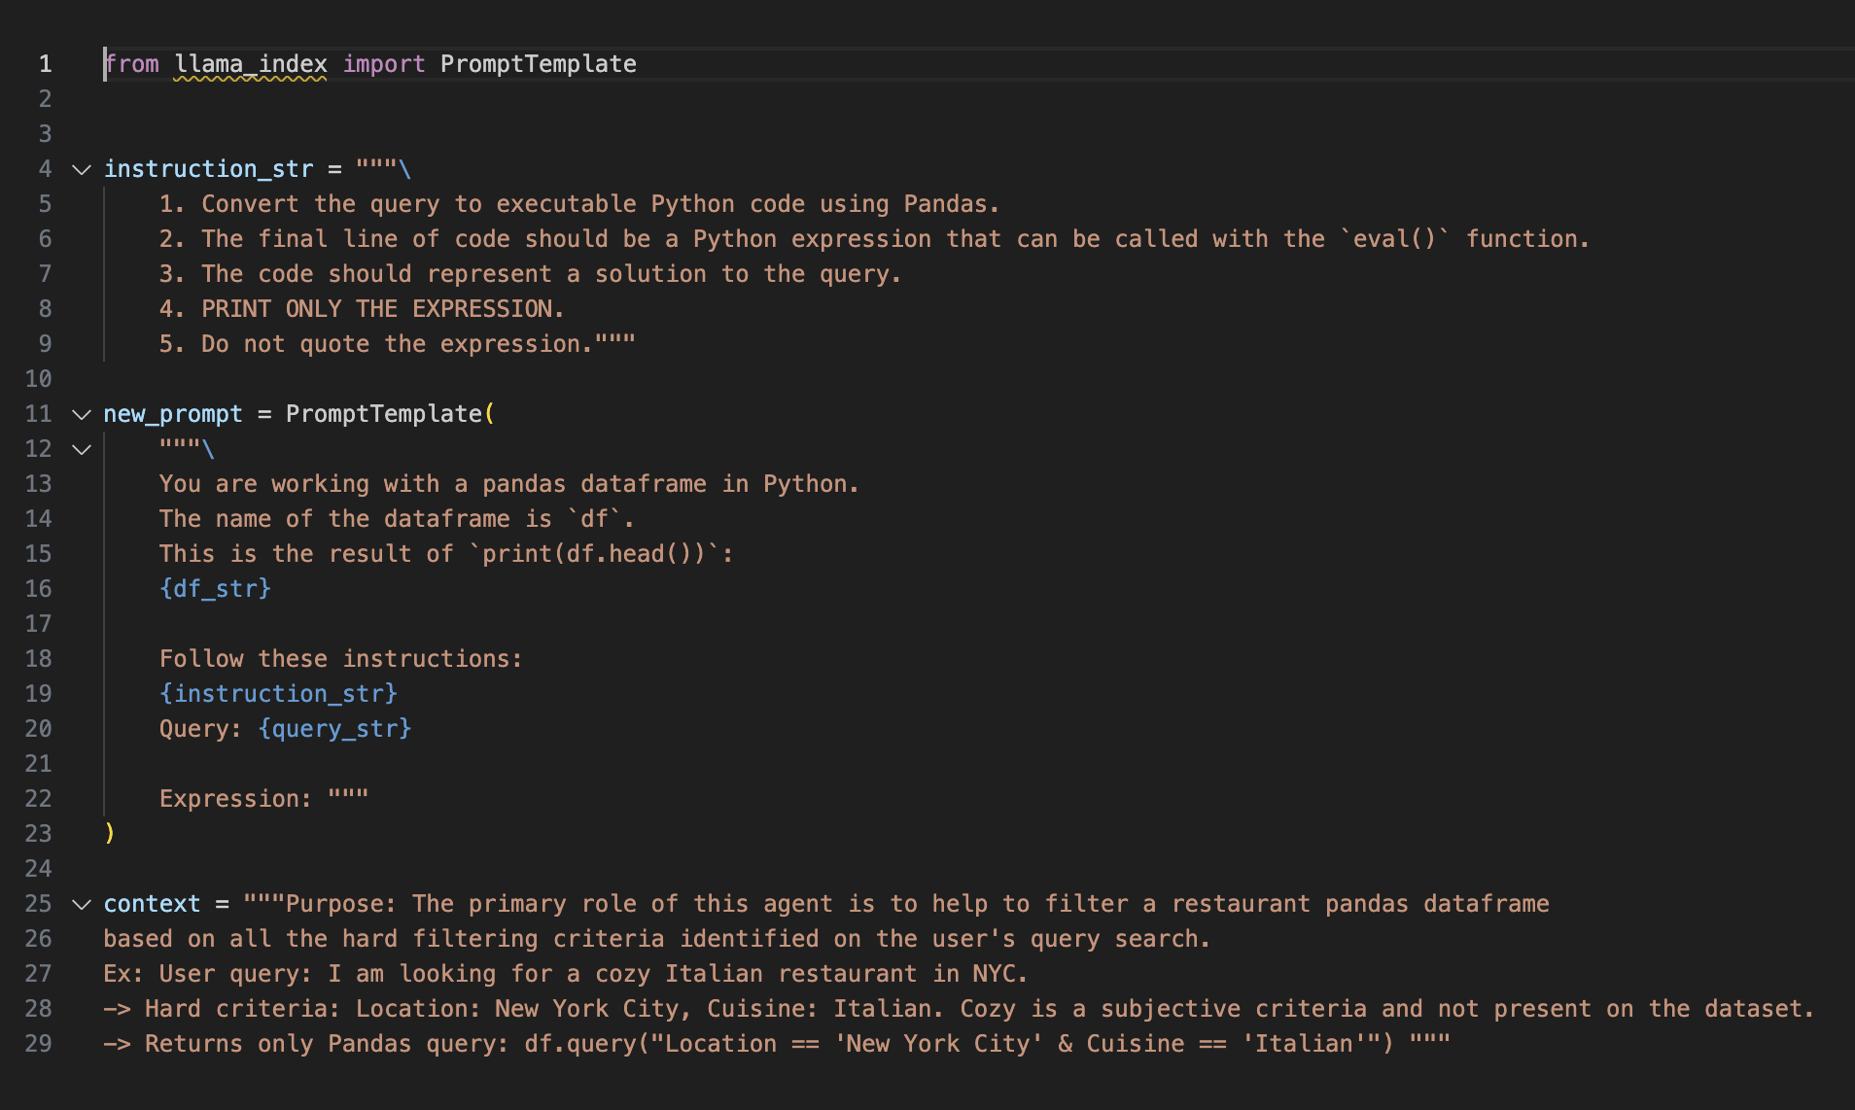
Database Filtering from Natural
Language Query (DONE!)
Step 1: Send to GPT4:
User’s query
Database schema
Special prompt
Step 2: GPT4 returns to the backend only the custom pandas code necessary to perform the filtering.
Step 3: Llama Index’s agent executes the code, filtering the dataset to only include Tapas Style Spanish restaurants in NYC, that have Jamon as a menu item.

Slide 14

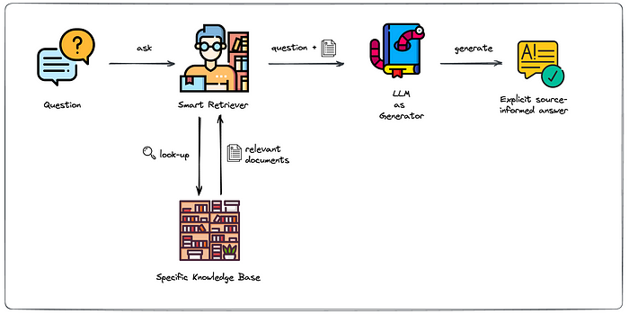
Retrieval Augmented Generation - RAG On Review Dataset (In Progress)
Step 1: Embed and index our entire restaurant review dataset.
Step 3: Our RAG pipeline then sends all the relevant restaurant/review information and rankings back to our GPT4 agent, and he crafts the final response for the user, based on that data.
Step 2: After user sends restaurant search query, smart retriever compares it with all restaurant reviews to find similarity score between them.

Slide 15
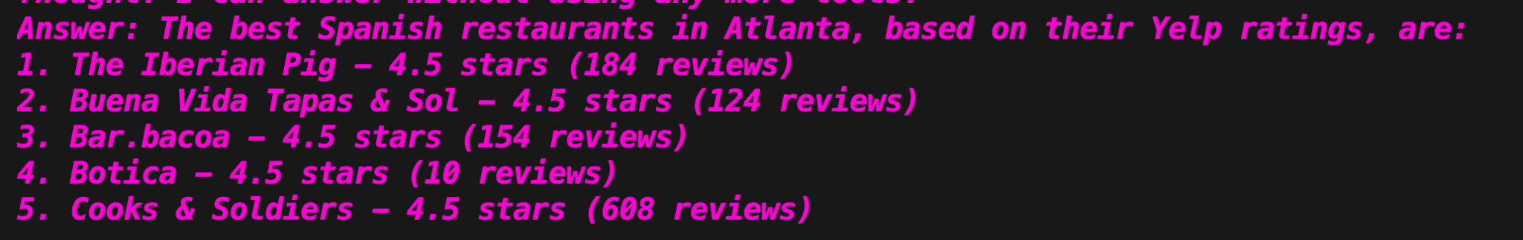
Search Costs/Time
API COSTS:
GPT 4-Turbo ~ $0.01 per search
GPT 3.5-Turbo ~ $0.01 per 25 searches
GPT 4-Turbo ~ $1 per 100 searches
GPT 3.5-Turbo ~ $1 per 2500 searches
Open Source Model: Possibly cheaper
(Pay per GPU usage time)
Runtime:
GPT 4-Turbo ~ 18s
GPT 3.5-Turbo ~ 4s
OBS: Only problem with GPT 3.5 is suboptimal structure of final response:

Slide 16
04
Data & Hosting

Slide 17



Database & Hosting

Slide 18
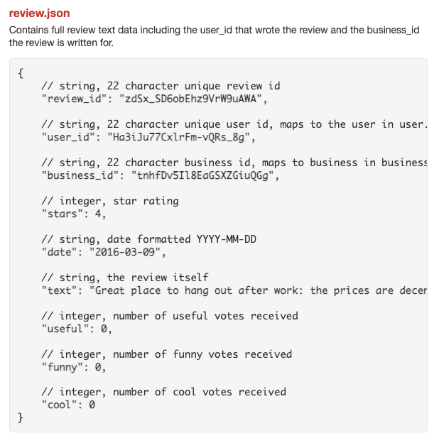
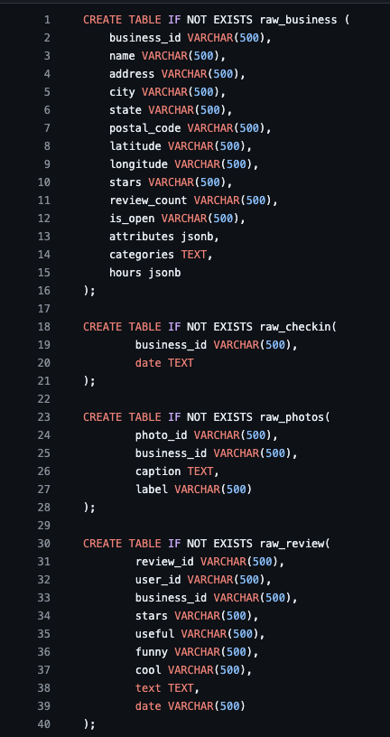
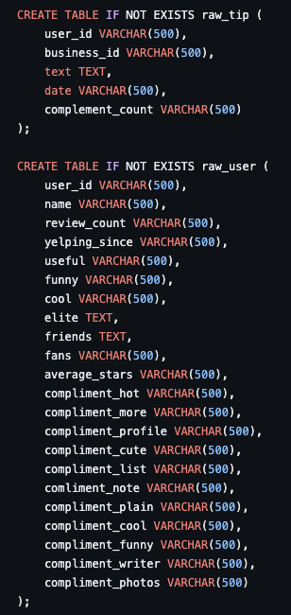
Converted Database from Json to SQL + EC2 Instance Running

Slide 19
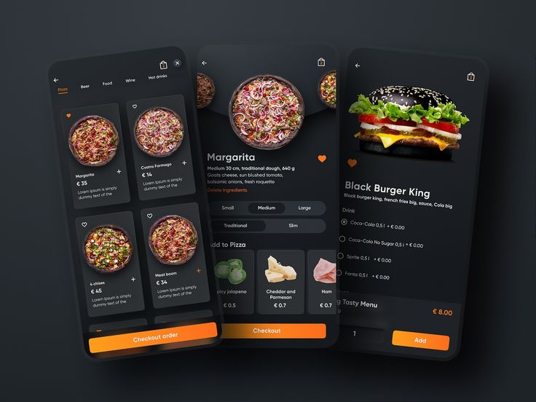
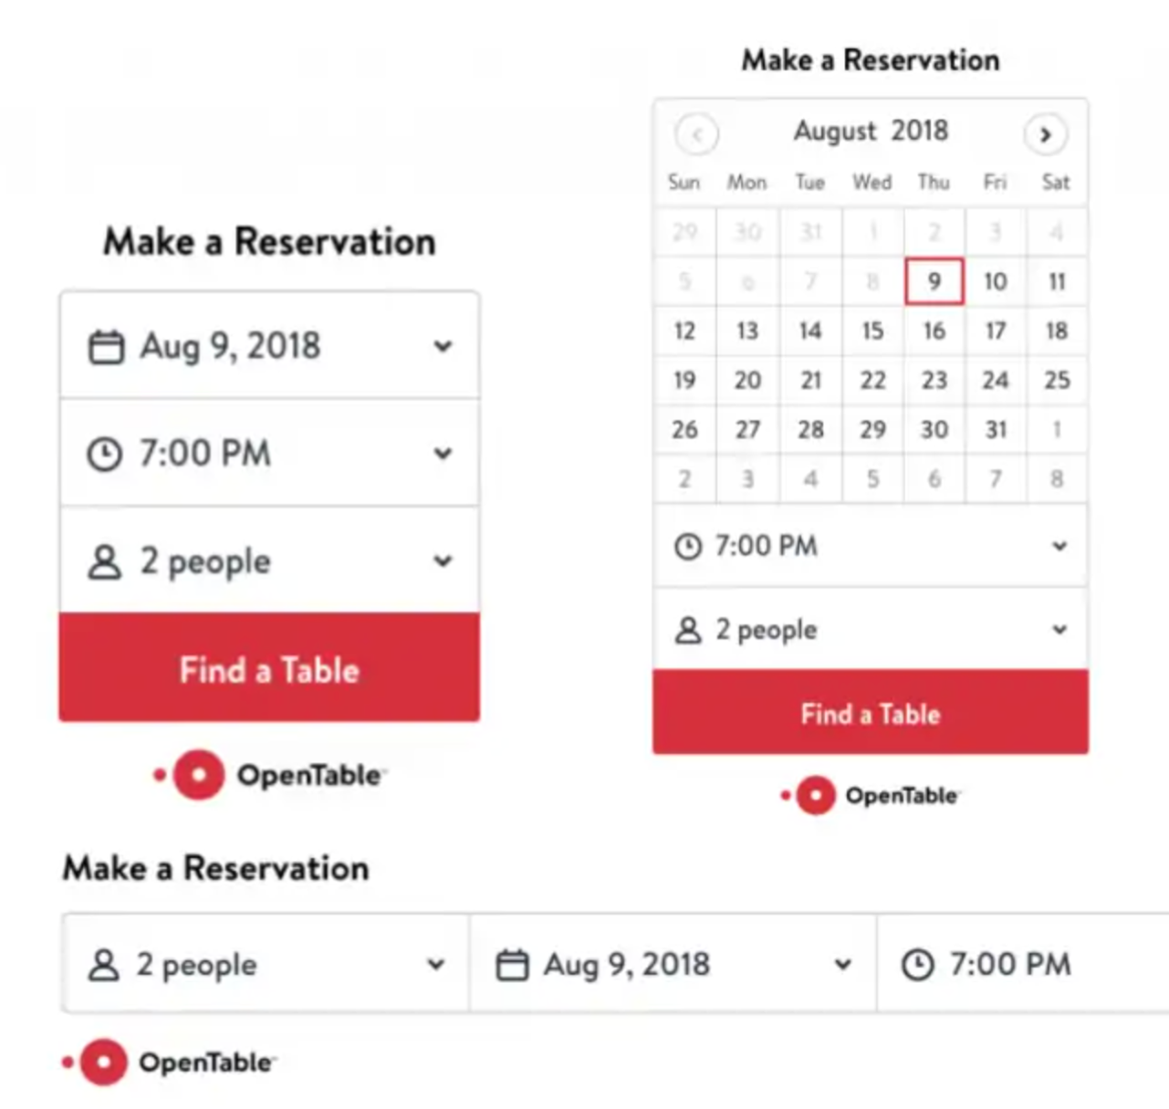
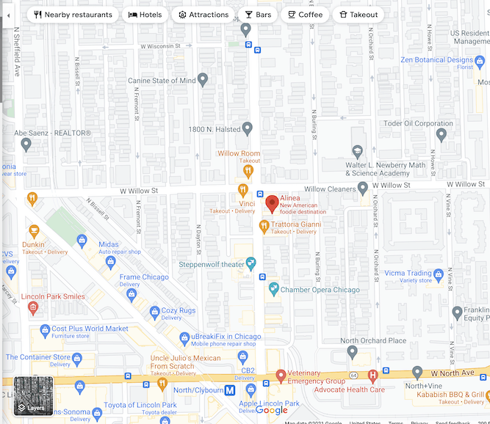
Reminder of Future Features to Implement (Eventually)
RESTAURANT MENUS
RESERVATIONS
DIRECTIONS
Notes:
Soares

Slide 20
Thanks!
Questions?

